Slide 1
Mini Project Presentation on Credit Risk Analysis using Artificial Neutral Networks
Submitted by:
Y Ningthoibi Devi (Reg. No. 201700218)
Bidisha Borgohain (Reg. No.-201700349)
Pushkar Srivastava (Reg. No.-201700331)
B.Tech 6th Semester, CSE, SMIT
Under the guidance of:
Chitrapriya N.
Assistant Professor
Department of Computer Science And Engineering

Slide 2
ABSTRACT
Credit risk or credit default indicates the probability of non- repayment of bank financial services that have been given to the customers.​
Credit risk plays a crucial role for banks and financial institutions, especially for commercial banks and it is always difficult to interpret and manage the credit risk.​
Neural network algorithms has the ability to tackle the problem of analysing credit default and predicting the credit worthiness of the loan application over a time period.​

Slide 3
INTRODUCTION
Our project entitled “Credit Risk Analysis Using Artificial Neural Networks” aims to analyse the risk associated with granting loans to customers in a financial institutions using Artificial Neural Networks and predict whether a customer is risky or non risky depending on how much he/she is capable of paying back the loan.
Artificial Neural Network connection between two neurons indicates the pathway for the flow of information. Each connection has a weight, an integer number that controls the signal between the two neurons.

Slide 4
If the network generates a “good or desired” output, there is no need to adjust the weights. However, if the network generates a “poor or undesired” output or an error, then the system alters the weights in order to improve subsequent results.
In this project, we aim to use Supervised Learning technique.
Supervised learning is a learning in which we teach or train the machine using data which is well labelled that means some data is already tagged with the correct answer. After that, the machine is provided with a new set of examples(data) so that supervised learning algorithm analyses the training data (set of training examples) and produces a correct outcome from labelled data.

Slide 5
SI No.​ | Paper and Author Details​ | Findings​ | Relevance to the Project​
1.​ | Name:Credit Risk Prediction Using Artificial Neural NetworksAuthor: Shruti Goyal[I]​​​​ | 1.This paper has studied the Artificial Neural Networks and Linear Regression models for credit default.2.Both the models had equal effect on the dataset and gave efficient results. Artificial Neural Networks gave an accuracy of 97.67% and linear regression of 97.69%.3.While fitting a model using the neural network process, user needed to take extra care of the attributes and the normalization of the data to improve the performance. ​​ | 1.Efficiency of the Artificial Neural Networks to improve the performance of the model.2.The importance of the attributes and data normalization in determining the efficiency of the neural network.
2. | Name:Measuring Credit Risk of Bank Customers Using Artificial Neural NetworkAuthors:Mohsen Nazari, Mojtaba Alidadi[II] | 1.This paper determines the most important discriminants for rating the customers in an Iranian Bank.2.Individual loan frequency and the loan amount had the most importance and status of the customer’s bank account ,previous relation with the bank had the least importance in the determination of classification of bad and good customers.3. The model has been build using one hidden layer and hyper tangent activation function. | 1.The architecture of the ANN model.2.The importance of attributes like loan frequency and loan amount in the classification of good and bad customers.

Slide 6
3. | Name:Evaluating Credit Risk Using Artificial Neural NetworksAuthor: Qeethara K. Al-Shayea and Ghaleb A.El-Refae [III] | 1.Two well known and available datasets have been used (German and Australian dataset) to test the neural network using feedforward back propagation neural network.2.The accuracy on the German dataset is 77% and on the Australian Dataset is 86%.3.The results of applying the proposed neural networks to distinguish between the customers based upon selected parameters showed very good abilities of the network to learn patterns. | 1.Use of the neural network model with learning algorithm: the feed forward back propagation neural network with supervised learning in terms of their ability to classify bad or good customers.
4. | Name:Credit Risk Prediction: A comparative study between Discriminant Analysis and the neural network approach.Author: ihem Khemakhem ,and Younés Boujelbènea [IV] | 1.The neural network approach differs from the conventional method of credit scoring in its nature of the black box and its ability to handle the non- linear relations between variables.2.The back-propagation algorithm was applied on the entire learning dataset.3.Neural network outperforms the discrimant analysis in the credit risk prediction. | 1.use of back-propagation algorithm to decrease the error

Slide 7
PROBLEM DEFINITION
Credit risk develops from the probability that the borrowers may be unwilling or unable to fulfill their contractual obligations.​
There is a crucial need For any credit-granting institution, such as commercial banks and certain retailers, the ability to discriminate good customers from bad ones.

Slide 8
SOLUTION STRATEGY
An analysis of the data of the bank customers are done.
A feedforward artificial neural network is used for developing the credit classification model. Here the information flow is unidirectional. There are no feedback loops. The inputs and outputs are fixed.
A training or learning algorithm , that is , the back-propagation algorithm is used to develop the model. This algorithm learns by example. We submit to the algorithm what the network wants to do, that is, to differentiate between the risky and non-risky customers. It changes the networks weights so that it can produce the desired output for a particular input.

Slide 9
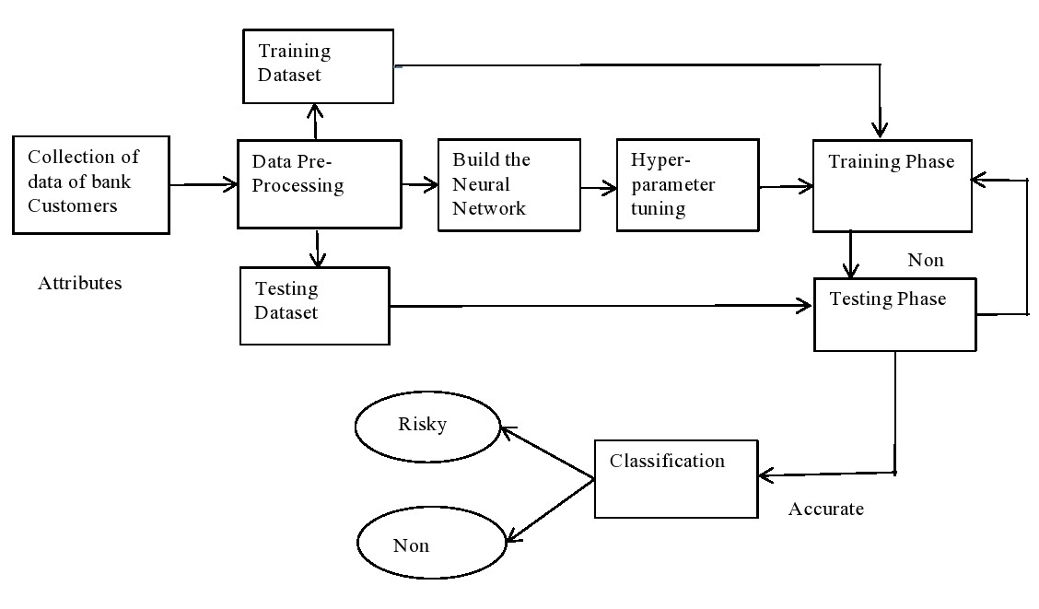
DESIGN
Accurate
Risky
Fig 1

Slide 10
Workflow:
Handling of categorical values
dummies=pd.get_dummies(data[i],prefix=i,dummy_na=False,sparse=True)
Handling of missing values
SimpleImputer(missing_values=np.nan,strategy='mean')
Scaling down the features
sklearn.preprocessing.normalize(x1,norm='l2',axis=1,copy=True,return_norm=False)
Feature Selection
SelectFromModel(Lasso(alpha=0.005,random_state=0))
Spliting of the training and testing set
skf=StratifiedKFold(n_splits=2)
skf.get_n_splits(x,y)
Hyperparameter Tuning param_grid=dict(layers=layers,activation=activations,batch_size=batch_size,epochs=epochs)
grid=GridSearchCV(estimator=model,param_grid=param_grid)

Slide 11
Building the Neural Network
model=Sequential([Dense(16,input_dim=19,activation="relu"),Dense(3,activation="relu"),Dense(2,
activation="softmax")])
model.compile(Adam(lr=0.001),loss="sparse_categorical_crossentropy",metrics=["accuracy"])
Training the Neural Network
model1.fit(X1_train,y1_train ,validation_split=0.1,batch_size=20 ,epochs=100)
Testing the Neural Network
rounded_predictions=model1.predict_classes(X1_test,batch_size=10,verbose=0)
Checking the accuracy of the neural network
classification_report(y1_test,rounded_predictions,target_names=target_names)

Slide 12
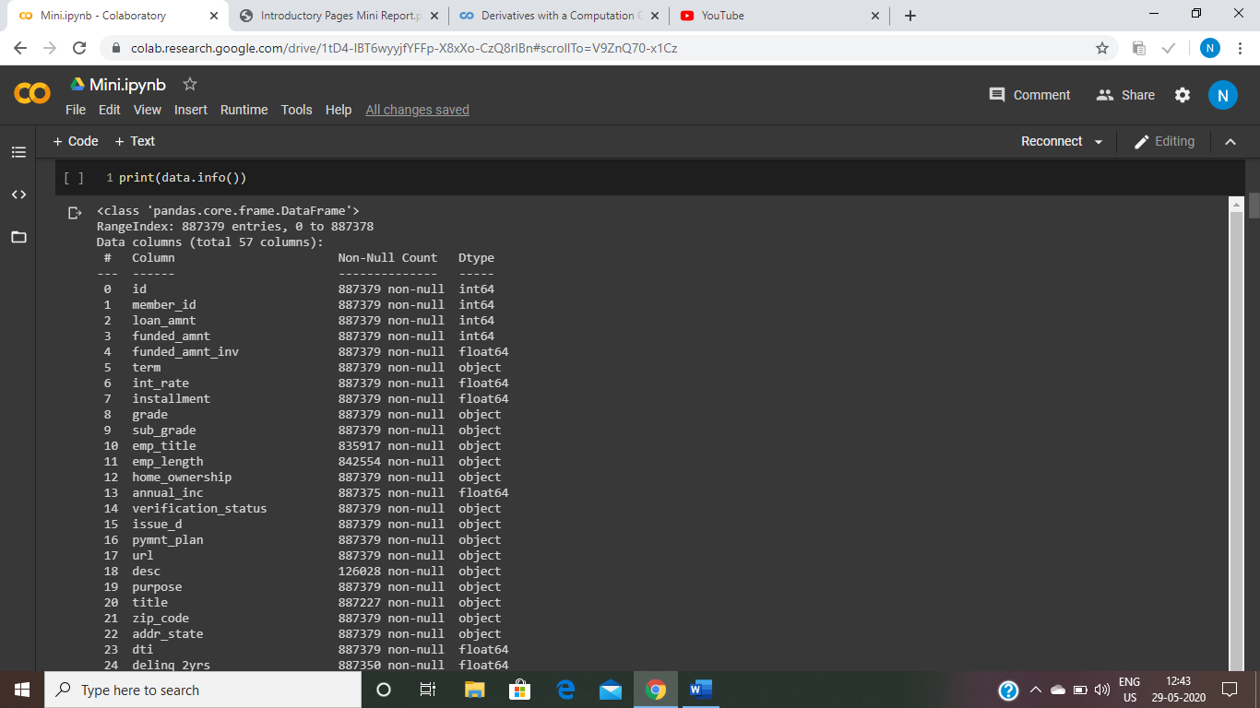
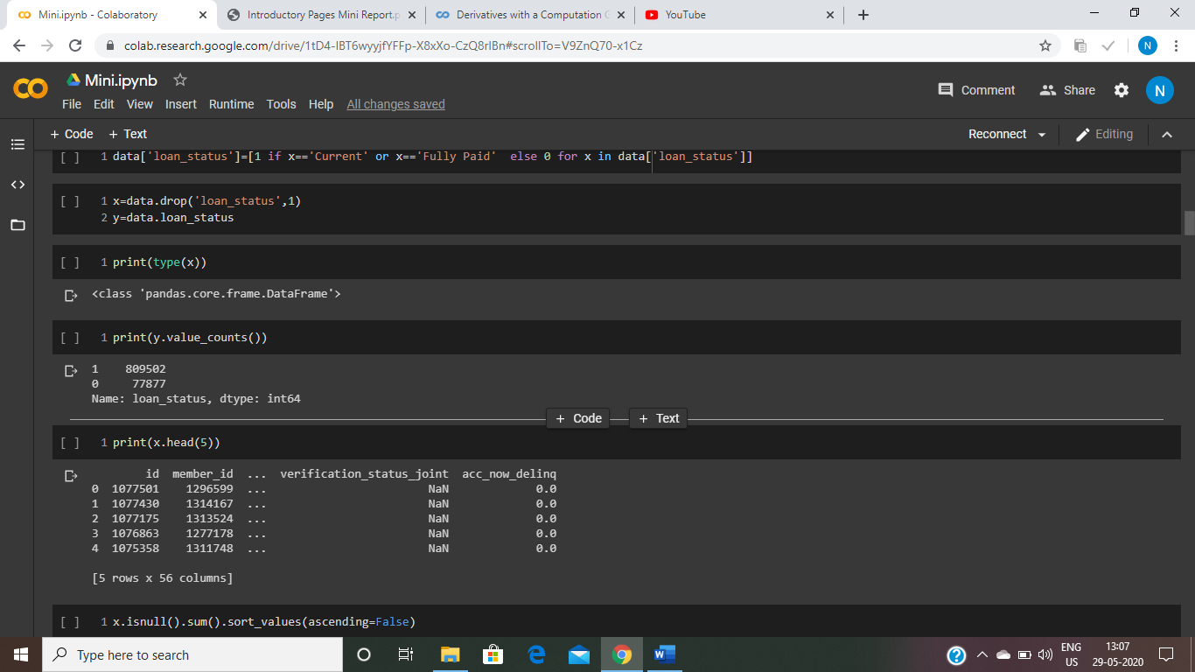
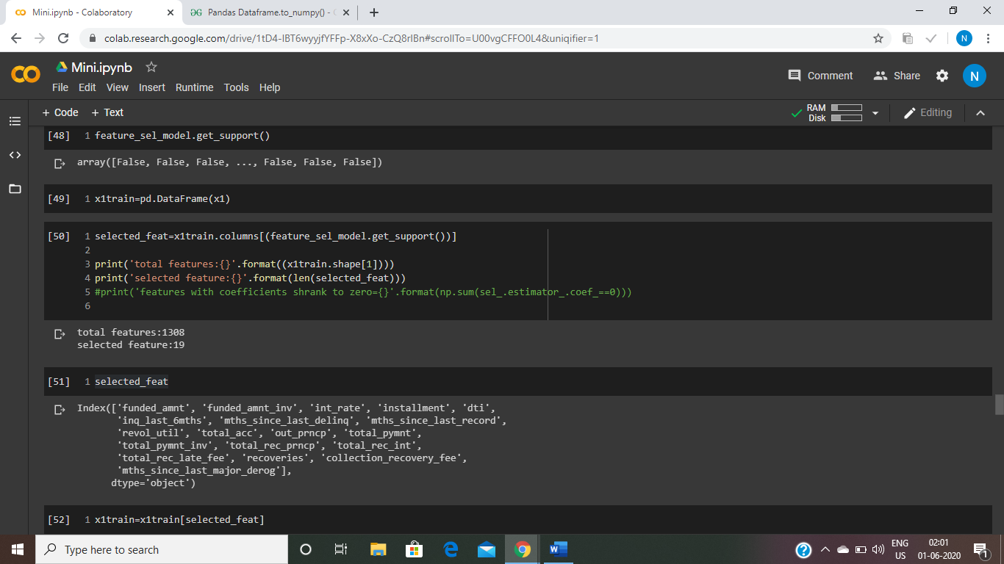
EXPERIMENTAL RESULTS
About the dataset(before pre-processing)(refer fig 2)
Total no of features: 57 features(56 independent feature, 1 dependent feature)
Total no of rows(total no of customer data): 887379
About the dependent variable(refer fig 3)
Label ‘1’ denotes non risky customers, Label ‘0’ denotes risky customers
Total no of non risky customers=809502 ;Total no of risky customers= 77877
After feature selection,(refer fig 4)
Total no of important features=19
Fig 2
Fig 3
Fig 4

Slide 13
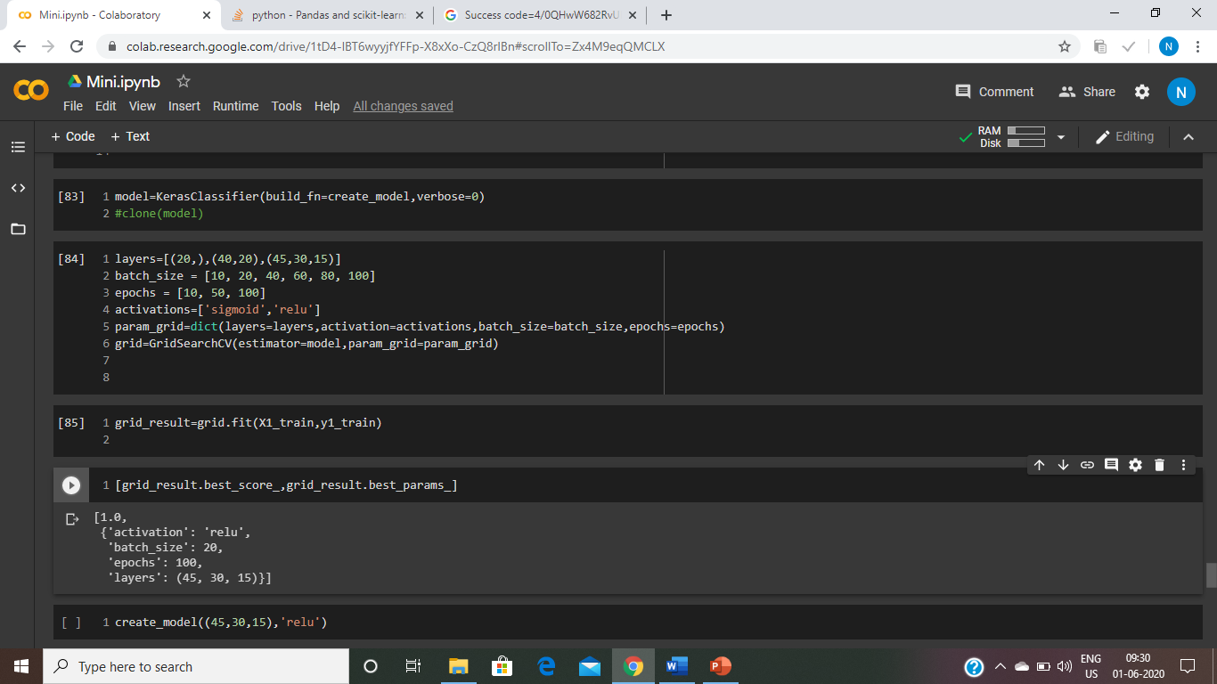
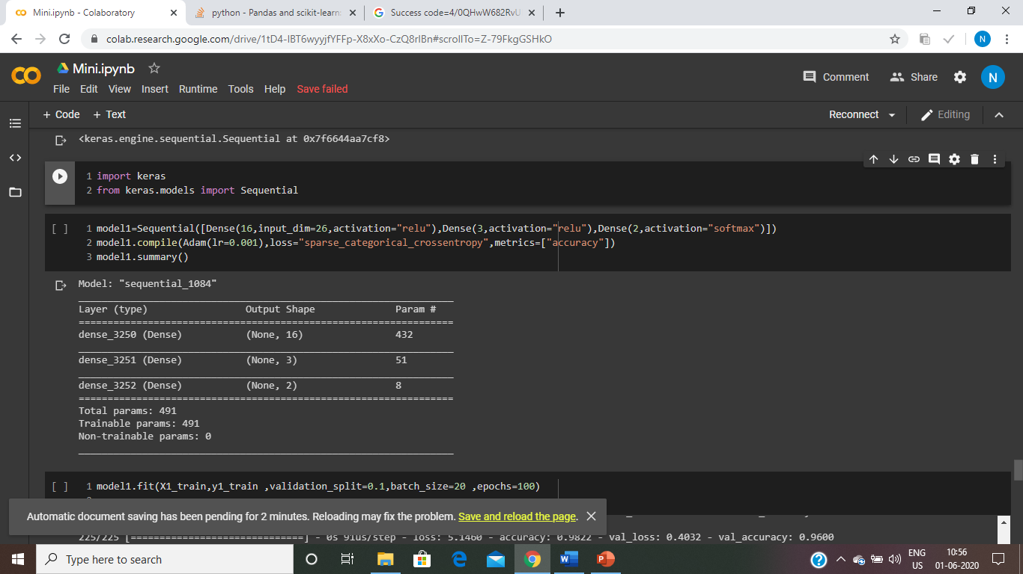
Hyperparameter tuning(refer fig 5)
No of hidden layers=3
Batch size=20
No of epochs=100
Activation function at the hidden layer=‘relu’
About the neural network(refer fig 6)
Optimisers used=Adam
Learning rate=0.001
Loss=sparse categorical crossentropy
Fig 5
Fig 6

Slide 14
Training results
Testing and the prediction results
No of training sample | No of validation sample | Training accuracy | Validation accuracy
450 | 50 | 0.9689 | 0.9600
900 | 100 | 0.9667 | 0.9500
2250 | 250 | 0.8293 | 0.8800
4500 | 500 | 0.8338 | 0.9460
22500 | 2500 | 0.8497 | 0.8232
45000 | 5000 | 0.8392 | 0.8700
No of training samples | Precision | Recall
 | Risky | Non Risky | Risky | Non risky
450 | 0.96 | 0.97 | 0.92 | 1.00
400 | 1.00 | 0.95 | 0.76 | 1.00
2250 | 1.00 | 0.83 | 0.01 | 1,00
4500 | 0.88 | 0.85 | 0.01 | 1.00
22500 | 0.09 | 0.81 | 0.00 | 1.00
45000 | 0.00 | 0.85 | 1.00 | 0.92
Table 1
Table 2

Slide 15
CONCLUSION
Credit risk analysis system is an critical financial decision making system.
In our study of credit risk, we take different no of data samples and feed it to our artificial neural network and train the network and observe its prediction.
As, we feed more data sample in the neural network, the model is able to generalize better.
From the testing and validation result, we observe that the bank dataset we used, gives better prediction for non-risky customers.(refer table 2)

Slide 16
LIMITATIONS & FUTURE SCOPE:
We can integrate an user interface to make the credit risk analysis system more user friendly for the bank
The data and features of a bank customer that determines their debt repayment capacity may change with time. Hence, the dataset used might go outdated.

Slide 17
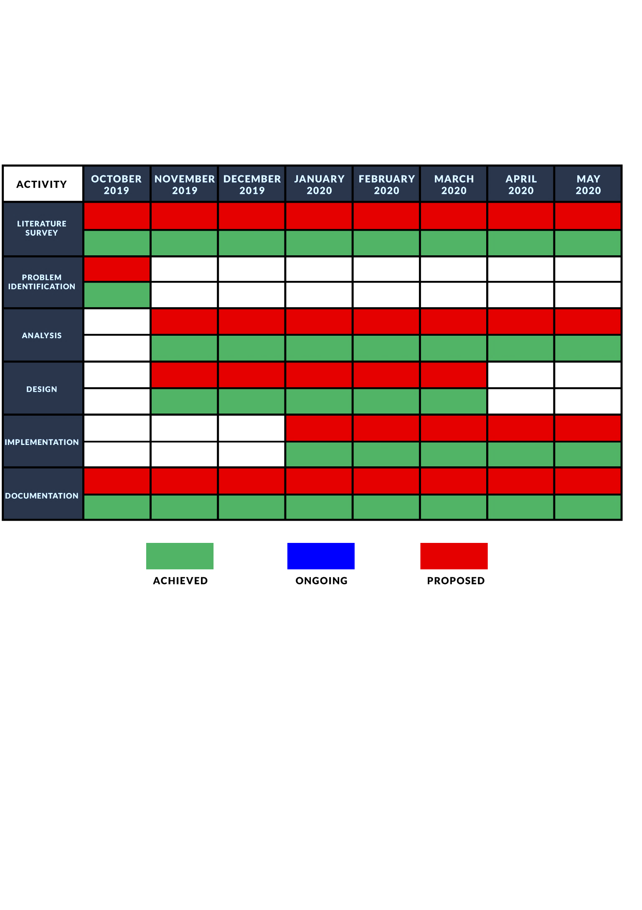
GANTT CHART

Slide 18
ACKNOWLEDGEMENT
We take this opportunity to acknowledge our deep sense of gratitude to our guide Chitrapriya N whose valuable guidance and kind supervision gave us throughout the course which shaped the present work as it shows.
We pay our deep sense of gratitude to Prof. (Dr.) Kalpana Sharma, H.O.D, CSE Dept, SMIT for giving us the opportunity to work on this project.
We obliged to our project coordinators Dr. Sandeep Gurung, Mr. Santanu Kr. Misra, Mr. Biraj Upadhyaya and Ms. Nitisha Pradhan for elevating, inspiration and kind supervision in completion of our project.
We would also like to thank any other staff of CSE, SMIT for giving us continuous support that has helped us in completion of our project.
Y Ningthoibi Devi (Reg. No.-201700218)
Bidisha Borgohain (Reg. No.-201700349)
Pushkar Srivastava (Reg. No.-201700331)

Slide 19
REFERENCES
[1] Shruti Goyal,”Credit Risk Prediction Using Artificial Neural Network Algorithm.”,
https://www.datasciencecentral.com/profiles/blogs/credit-risk-prediction-using-artificial-neural-network-algorithm, Accessed at:17.01.20, 10:45 pm
[2] Mohsen Nazari,” Mojtaba Alidadi,Measuring Credit Risk of Bank Customers Using Artificial Neural Network”, Journal of Management Research ISSN 1941-899X,April 1, 2013
[3] Qeethara K. Al-Shayea and Ghaleb A.El-Refae, “Evaluating Credit Risk Using Artificial Neural Networks”,https://www.researchgate.net/publication/298563719_Evaluating_Credit_Risk_Using_Artificial_Neural_Networks, Accessed at:18.01.2020, 6:30pm
[4] Ihem Khemakhem ,and Younés Boujelbènea, “Credit Risk Prediction: A comparative study between Discriminant Analysis and the neural network approach.”,Accounting and Management Information Systems Vol. 14, No. 1, pp. 60-78,2015
.

